Slide 1
Algorithmic composition using data mining
Tom richmond | Imad Rahal, Ph. D

Slide 2
Music and science
Music was considered a branch of science until quite recently
Most mathematical of all art forms
Numbers best represent both intervals and note duration
Attractive to apply scientific methods to the subject

Slide 3
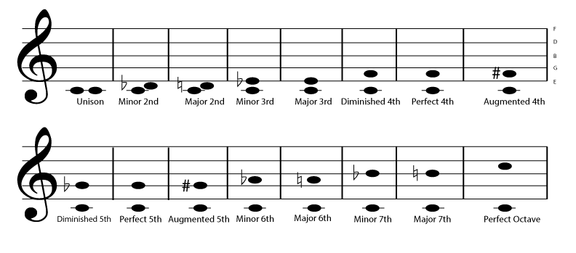
Note Intervals
An interval is the distance between any two successive notes in a piece of music (Fig. 2)
Western music implements an equal-tempered musical scale known as the chromatic scale (Fig. 3).
Between each successive note on the chromatic scale is an interval known as a semitone (100 cents).
Ratios further make music a uniquely mathematical art form
Fig. 2
Fig. 3

Slide 4
Identifying between eras
Western classical music is split into 6 distinct era (Fig. 1)
Medieval, Renaissance, Baroque, Classical, Romantic, Modern
Years are not well agreed upon, but stylistic differences are
Trained musicians have the ability to listen to a piece and determine from which era it was spawned
Fig. 1

Slide 5
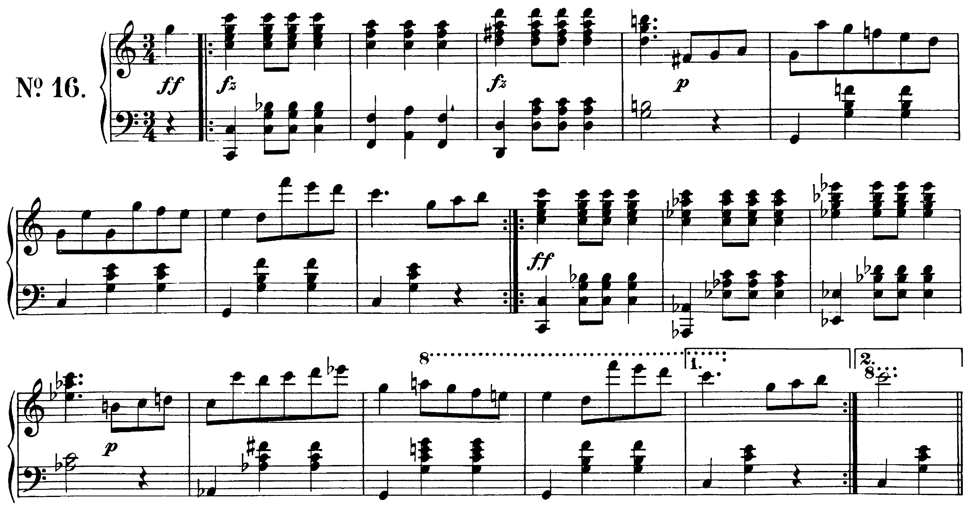
Musical Representation
Classical Music is recorded by way of a score, or sheet music (Fig. 4)
Instructs
instrumentalists
on what to play at
what times.
Contains a number
of important features
How to translate for a computer?
Fig. 4

Slide 6
Data set
**kern format is digital, textual representation of a musical score
The **kern scheme allows the encoding of pitch and duration, as well as accidentals, articulation, ornamentation, ties, slurs, phrasing, glissandi, barlines, stem-direction and beaming.
Flexible toolkit (Humdrum)
MIDI Format
**kern preferred for ease of understanding visually
Encoding
Benefits of MIDI include ability to play back music without conversion

Slide 7
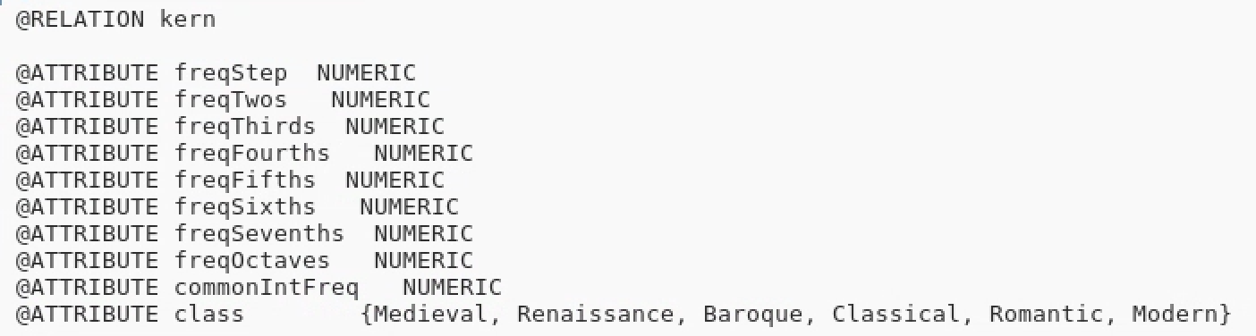
Data extraction
List of key features to be extracted from set (Fig. 5)
Had many variations, decided upon for sake of classification results and usefulness in generation
Linux Command using Humdrum Toolkit
Loop over **kern files within folder to extract information relevant to key features.
Fig. 5

Slide 8
Extraction sample
for file in *.krn ; do t=$(grep -o '[MmPAd]' mint/int_$file | wc -w) ; a=$(grep -o '[MmPAd]1' mint/int_$file | wc -w) ; b=$(grep -o '[MmPAd]2' mint/int_$file | wc -w) ; c=$(grep -o '[MmPAd]3' mint/int_$file | wc -w) ;
…
echo $(bc -l <<< "($a/$t)")','$(bc -l <<< "($b/$t)")','$(bc -l <<< "($c/$t)”)
…
‘,Medieval'>>../TrainingSet.arff ; done

Slide 9
Final dataset
Data set presented in .arff format
Linux Command created with .arff in mind, work already done based on output
Example line from .arff:
.05729166666666666666,.62395833333333333333,.15208333333333333333,.05520833333333333333,.05416666666666666666,.00833333333333333333,.00729166666666666666,.00416666666666666666,.62395833333333333333,.20565552699228791773,.07840616966580976863,.12596401028277634961,.23136246786632390745,.20822622107969151670,.14910025706940874035,.18380462724935732647,.23136246786632390745,.24373956594323873121,.90000000000000000000,.51562500000000000000,.28020833333333333333,.16562500000000000000,.00104166666666666666,0,Medieval

Slide 10
Weka classifiers
Many methods used with many different versions of dataset
Varied results using different classifiers: SVM (Fig. 6)(Multilayered Perceptron), Logistic Regression (Fig. 7) , Naïve Bayes (Fig. 8), JRip (Fig. 9) and J48 (Fig. 10).
Results vary, but lower level classifiers important for ease of output

Slide 11
Weka classifiers
Fig. 6
Fig. 7
Fig. 8
Fig. 9
Fig. 10

Slide 12
Deciding between classifiers
While more complex classifiers, such as SVMs and Logistic Regression Models, have yielded significantly more impressive results, the nature of their classification makes it hard to use in a generative way
Rule based classifiers like JRip and J48 yielded less accurate results, but lend themselves better to the generative process
Balance must be found between two.
Naïve Bayes chosen as a middle ground
(83.8% ROC)

Slide 13
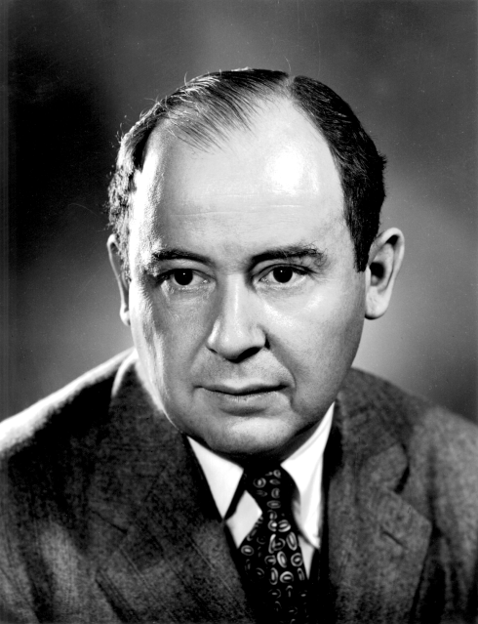
Cellular Automata Overview
Cellular Automata (singular: Automaton) is a structural system that attempts to mimic the cellular replication process
First proposed as a system by John von Neumann (Fig. 11) in the 60’s
Each cell has one of a finite number of states. New states determined by state of neighbors
1D and 2D Automata are most common
Fig. 11

Slide 14
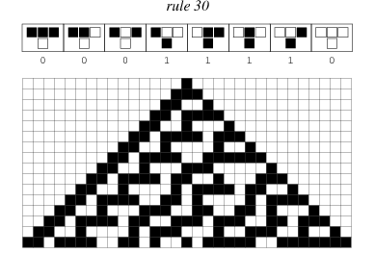
1D Cellular Automata
Most famous 1D Cellular Automata: the Wolfram Elementary Algorithm
Based on selected rule, bottom row will evolve relative to only the previous row (Fig. 12)
Wolfram algorithm seeks the value of three Automatons above to determine value of new automaton. (111 -> 0)
Fig. 12

Slide 15
Binary representations
In a two-state automata model, using binary, it is possible to represent these previously discussed note values in a four byte number, from 0000 – 1111
Fig. 13 demonstrates distribution, with 16 values available, 12 notes, a rest, as well as START and TERMINATE values. C duplicated.
Fig. 13

Slide 16
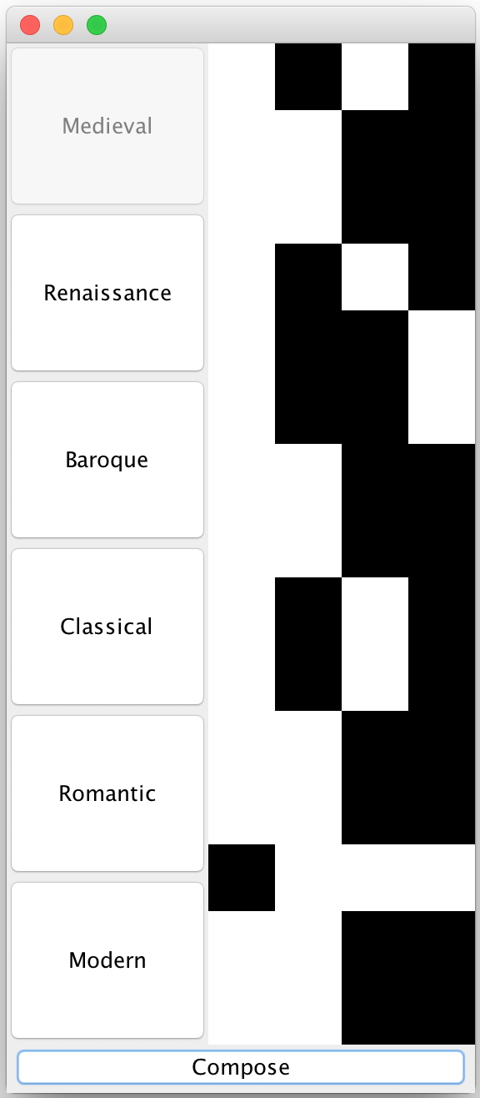
Cellular Automata rules
Four cell-wide automata for this model (Fig. 14)
Modified use of this Wolfram principle implemented, taking into account the value of all four cells of the previous sequence
This will change the value of the entire new sequence
Fig. 14

Slide 17
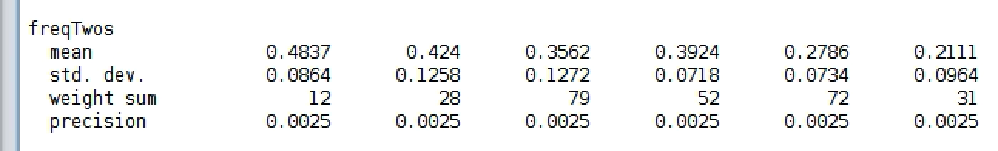
Rule Generation
Logistic Regression (83.8% ROC) favored for ease of use, and it’s natural use of probability
The rules will be derived using probability relative to results of the classifier
First, the previous sequence will reveal the most recent note
Then, next interval will be generated based on statistics from Naïve Bayes output (Fig. 15), and value will be changed relative to the previous sequence
Fig. 15

Slide 18
Range of piece
Another obstacle is musical range
Generation process with intervals alone allows for ever-increasing or decreasing phrases
Remedied by including range in classification process
Simple if-statement ensures piece adheres to the likely range of the era

Slide 19
Indirect Results
Using classifiers to determine success of generation
Fig. 16
Fig. 17
Fig. 18
Fig. 19

Slide 20
Direct results
Using experts to determine success of generation
Results as they come in are less than desired, but does not negate the potential of the system.
Experts have said that rhythm and harmony must be taken into account, as they are too important to the stylization differences of eras to make determinations
Gap between two analysis types shows work to be done

